Slide 1

Vel Tech Rangarajan Dr. Sagunthala R&D Institute of Science and Technology
School of Computing
Department of Computer Science and Engineering
10211CS224 / FULL STACK APPLICATION DEVELOPMENT (JAVA)
END SEMESTER PROJECT REVIEW
Date: 06-05-2026
JOB PORTAL MANAGEMENT SYSTEM
SDG 8: Decent Work and Economic Growth
Presented By:
D.Sri Venkata Siddardha– VTU27240– Reg.No.23UECS0712
Courses Handling Faculty:
Dr. HAFIZUR RAHMAN-Associate Professor

Slide 2
INTRODUCTION
1
Manual recruitment processes are often time-consuming, inefficient, and prone to errors. Job seekers may face challenges such as limited access to opportunities, lack of timely updates, and difficulty in tracking applications, while recruiters struggle with managing large volumes of applications manually. This project is important as it digitizes the entire recruitment process, making it faster, more transparent, and more efficient. It reduces manual effort and minimizes errors in candidate selection and data management.
In real-world scenarios, job portals are widely used by companies, consultancies, and organizations to streamline hiring. Implementing this system provides a centralized platform where job seekers can search and apply for jobs, upload resumes, and track application status easily. It also includes an admin/recruiter module to post job openings, manage applications, shortlist candidates, and maintain records efficiently, thereby improving the overall recruitment process.
2
3
4
5
6
7
8
9

Slide 3
PROBLEM STATEMENT
1
In many organizations and institutions, recruitment is still handled manually or through unstructured methods. This leads to delays in hiring, difficulty in managing a large number of applications, and lack of proper communication between job seekers and recruiters. Manual systems are prone to errors such as loss of candidate data, duplicate entries, and inefficient shortlisting processes. Job seekers often face challenges in finding suitable opportunities and tracking their application status. There is no centralized platform to manage job postings, applications, and candidate information effectively. This results in reduced efficiency and missed opportunities for both employers and applicants. Therefore, there is a need for a simple, secure, and automated Job Portal Management System. Such a system will improve accuracy, save time, and ensure a smooth and efficient recruitment process.
2
3
4
5
6
7
8
9

Slide 4
OBJECTIVE(S)
To develop a web-based system for online job search and application:
The objective is to design and implement an interactive web application that enables users to easily browse available job opportunities, view detailed job descriptions, and apply for jobs anytime from anywhere. This system provides a smooth user experience with simple navigation, reducing dependency on traditional and time-consuming job search methods.
To create an efficient admin/recruiter module for management:
The project aims to include a dedicated interface for recruiters that allows them to post and update job vacancies, manage applications, shortlist candidates, and track recruitment progress in real time. This improves coordination, reduces manual errors, and ensures efficient handling of large numbers of applicants.
To ensure a secure, fast, and user-friendly platform:
Another key objective is to build a reliable and secure system that protects user data, resumes, and application details. The platform will be optimized for performance and ease of use, making it accessible to all users while minimizing manual effort and improving the overall efficiency of the recruitment process.
1
2
3
4
5
6
7
8
9

Slide 5
PROPOSED SYSTEM
The proposed system is a web-based Job Portal Management System designed to simplify and streamline the recruitment process. It provides a centralized platform where job seekers can search for job opportunities, view detailed job descriptions, and apply instantly. The system eliminates manual and unorganized hiring methods, thereby reducing delays and saving time for both applicants and recruiters.
It ensures accurate data management by maintaining digital records of job postings, applications, and candidate information, avoiding duplication and errors. An integrated admin/recruiter module allows employers to efficiently post jobs, manage applications, shortlist candidates, and update recruitment status in real time.
The system improves transparency by providing real-time updates on application status and notifications to users. Compared to traditional recruitment methods, it offers greater convenience, accessibility, and reliability through automation. Overall, it enhances user experience and ensures a smooth, fast, and well-organized hiring process.
1
2
3
4
5
6
7
8
9

Slide 6
PROPOSED SYSTEM ARCHITECTURE
Input
The input includes user details such as login credentials, personal information, resume upload, and job preferences.
Recruiter/admin input includes job posting details like job title, company name, qualifications required, salary, and job description.
Processing
The system processes user requests by validating login credentials, matching user profiles with relevant job postings, and handling job application submissions.
It also processes recruiter actions such as posting jobs, shortlisting candidates, and updating application status while ensuring smooth interaction between users and recruiters.
Database
The database stores all important information such as user profiles, resumes, job postings, application records, and recruiter details.
It ensures secure storage and quick retrieval of data whenever required for efficient system performance.
Output
The output includes job listings, application confirmation, and status updates displayed to the user.
Recruiters/admin receive outputs such as applicant lists, shortlisted candidates, and reports on job postings and recruitment progress.
1
2
3
4
5
6
7
8
9

Slide 7
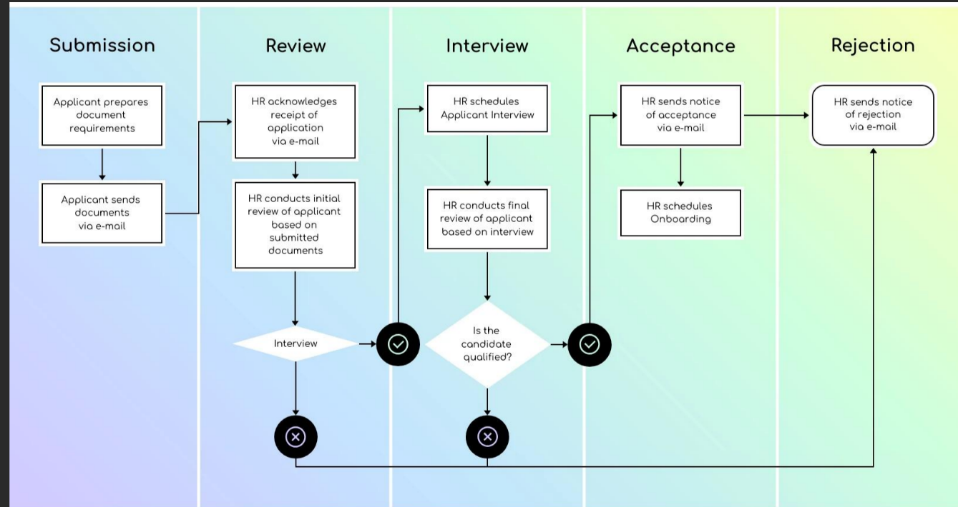
WORKFLOW
1
2
3
4
5
6
7
8
9

Slide 8
TECHNOLOGIES USED
Frontend: HTML, CSS, JavaScript, React.js
Backend: Node.js, Express.js
Database: MongoDB
APIs: Email/SMS Notification API
1
2
3
4
Tools
Visual Studio Code
Git & GitHub
Postman
Google Chrome
5
6
7
8
9

Slide 9
MODULE DESCRIPTION
Module 1: User Management
Handles user registration, login, and profile management with secure authentication.
Allows users to create accounts, upload resumes, update personal details, and track their job applications.
Module 2: Job & Application Management (Core Processing)
Manages job posting, job listing, and application process.
Processes user actions such as searching jobs, applying for jobs, and allows recruiters to manage job postings and applications efficiently.
Module 3: Database Management
Stores and manages user profiles, resumes, job details, recruiter information, and application records.
Ensures data integrity, consistency, and quick retrieval of information whenever required.
Module 4: Notification Module (Innovative Module)
Provides real-time notifications such as job alerts, application status updates, and interview notifications.
Uses Email/SMS services to keep users and recruiters informed and updated.
Module 5: Reporting & Analytics
Generates reports such as number of applicants, job postings, and recruitment progress.
Helps recruiters analyze data and make better hiring decisions.
1
2
3
4
5
6
7
8
9

Slide 10
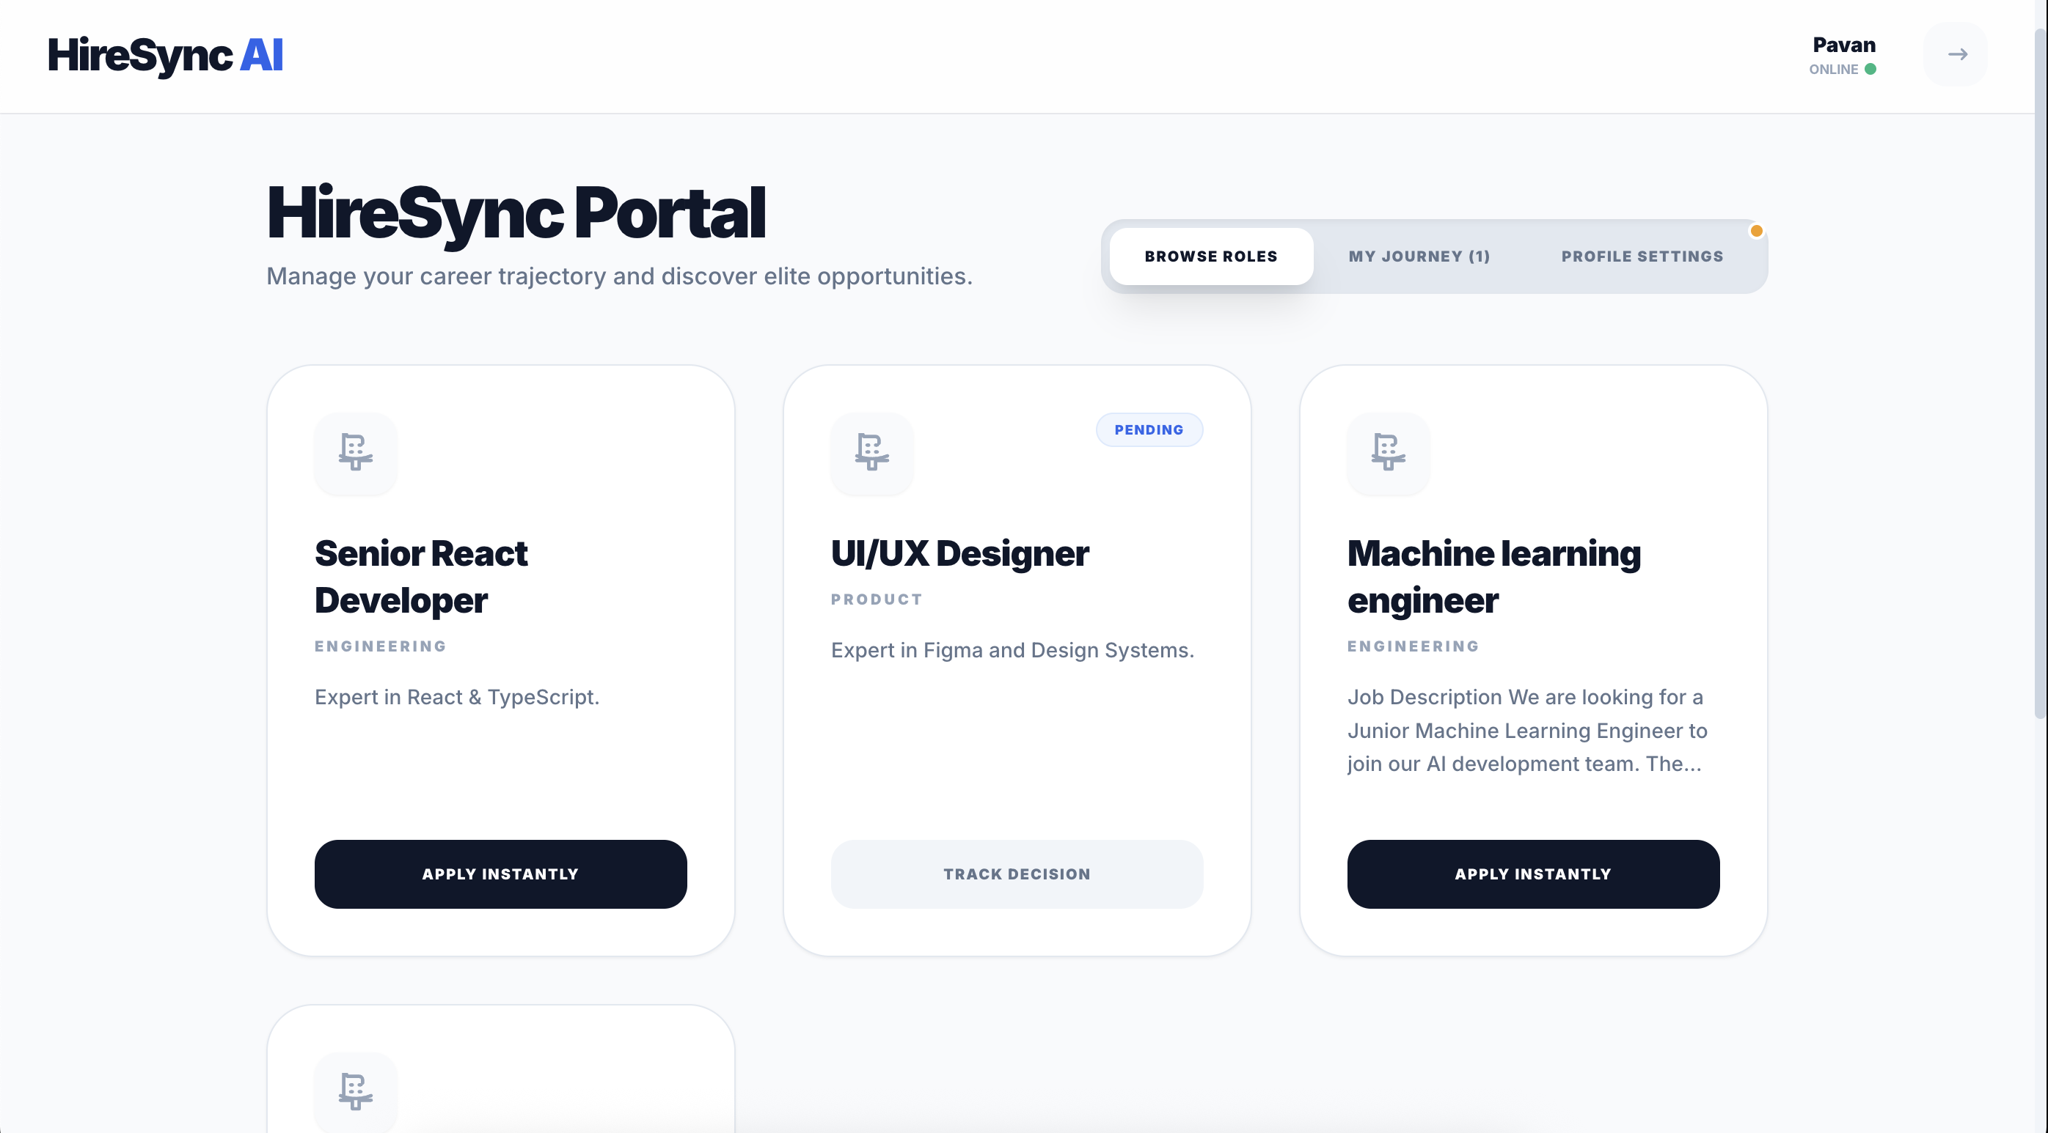
IMPLEMENTATION SCREENSHOTS
1
2
3
4
5
6
7
8(A)
This page displays a user-friendly job listing interface where users can search, filter, and browse available job opportunities with details such as job title, company name, location, and required skills.
It also allows users to quickly view job descriptions and apply for jobs online through a simple and interactive “Apply Now” option.
9

Slide 11
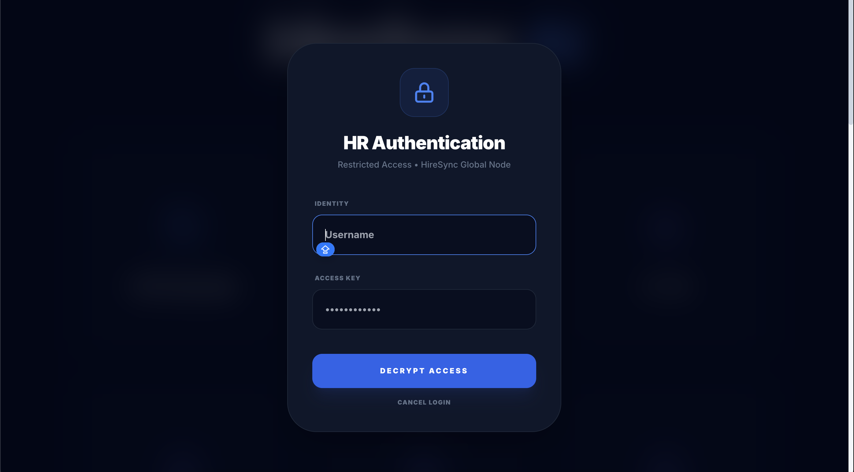
IMPLEMENTATION SCREENSHOTS
Admin Login Page
1
2
3
4
5
6
7
8(B)
9
This image shows a secure login page for the recruiter/admin side of a Job Portal system.

Slide 12
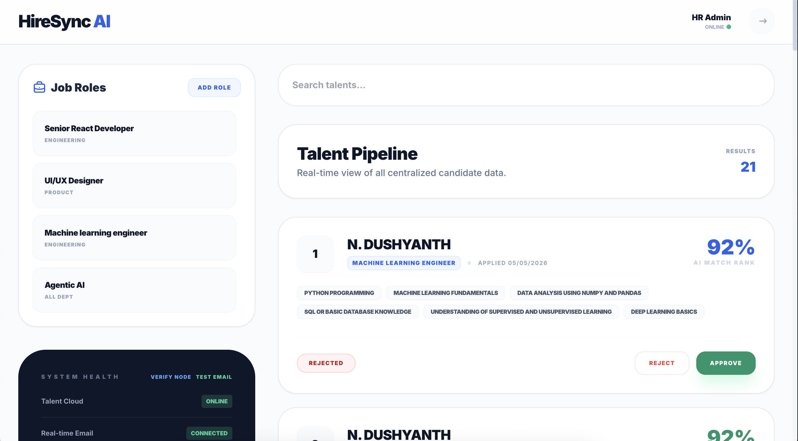
IMPLEMENTATION SCREENSHOTS
1
2
3
4
5
6
7
8(C)
9
This image shows an Admin Dashboard of a Job Portal Management System (HireSync AI).

Slide 13
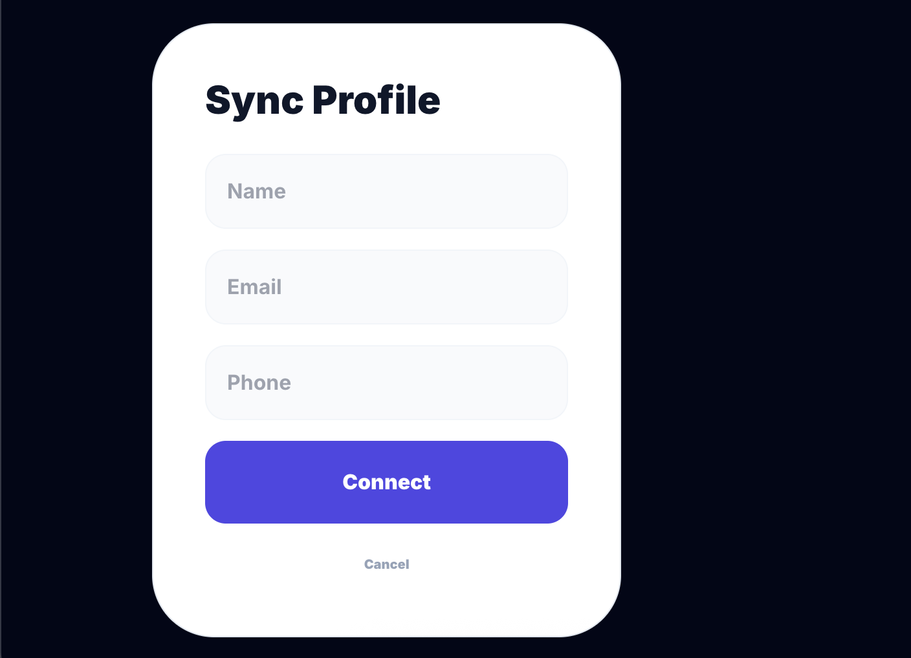
IMPLEMENTATION SCREENSHOTS
1
2
3
4
5
6
7
8(C)
9
This image shows a User Profile Form page in a Job Portal Management System.

Slide 14
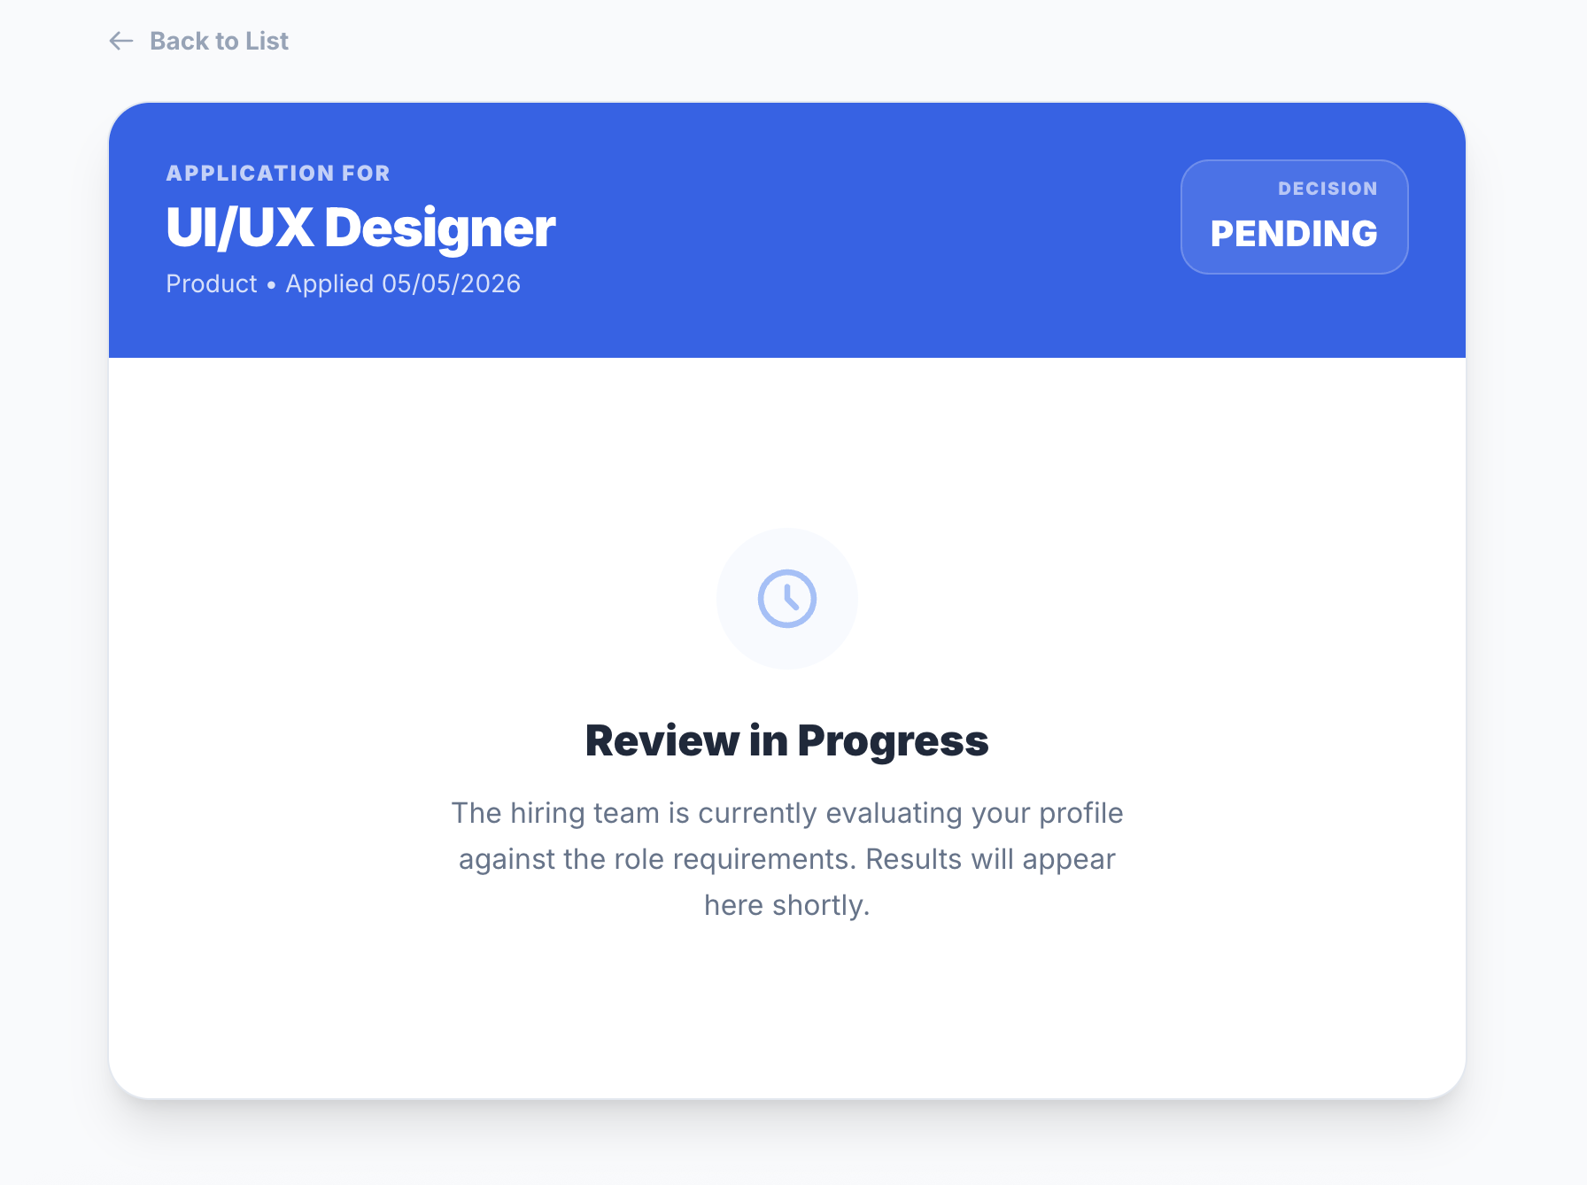
IMPLEMENTATION SCREENSHOTS
1
2
3
4
5
6
7
8(C)
9
This image shows an application status page in a Job Portal Management System. It displays that the user has applied for the role of UI/UX Designer, and the current status is marked as Pending. The page indicates that the application is under review, and the hiring team is evaluating the candidate’s profile.

Slide 15
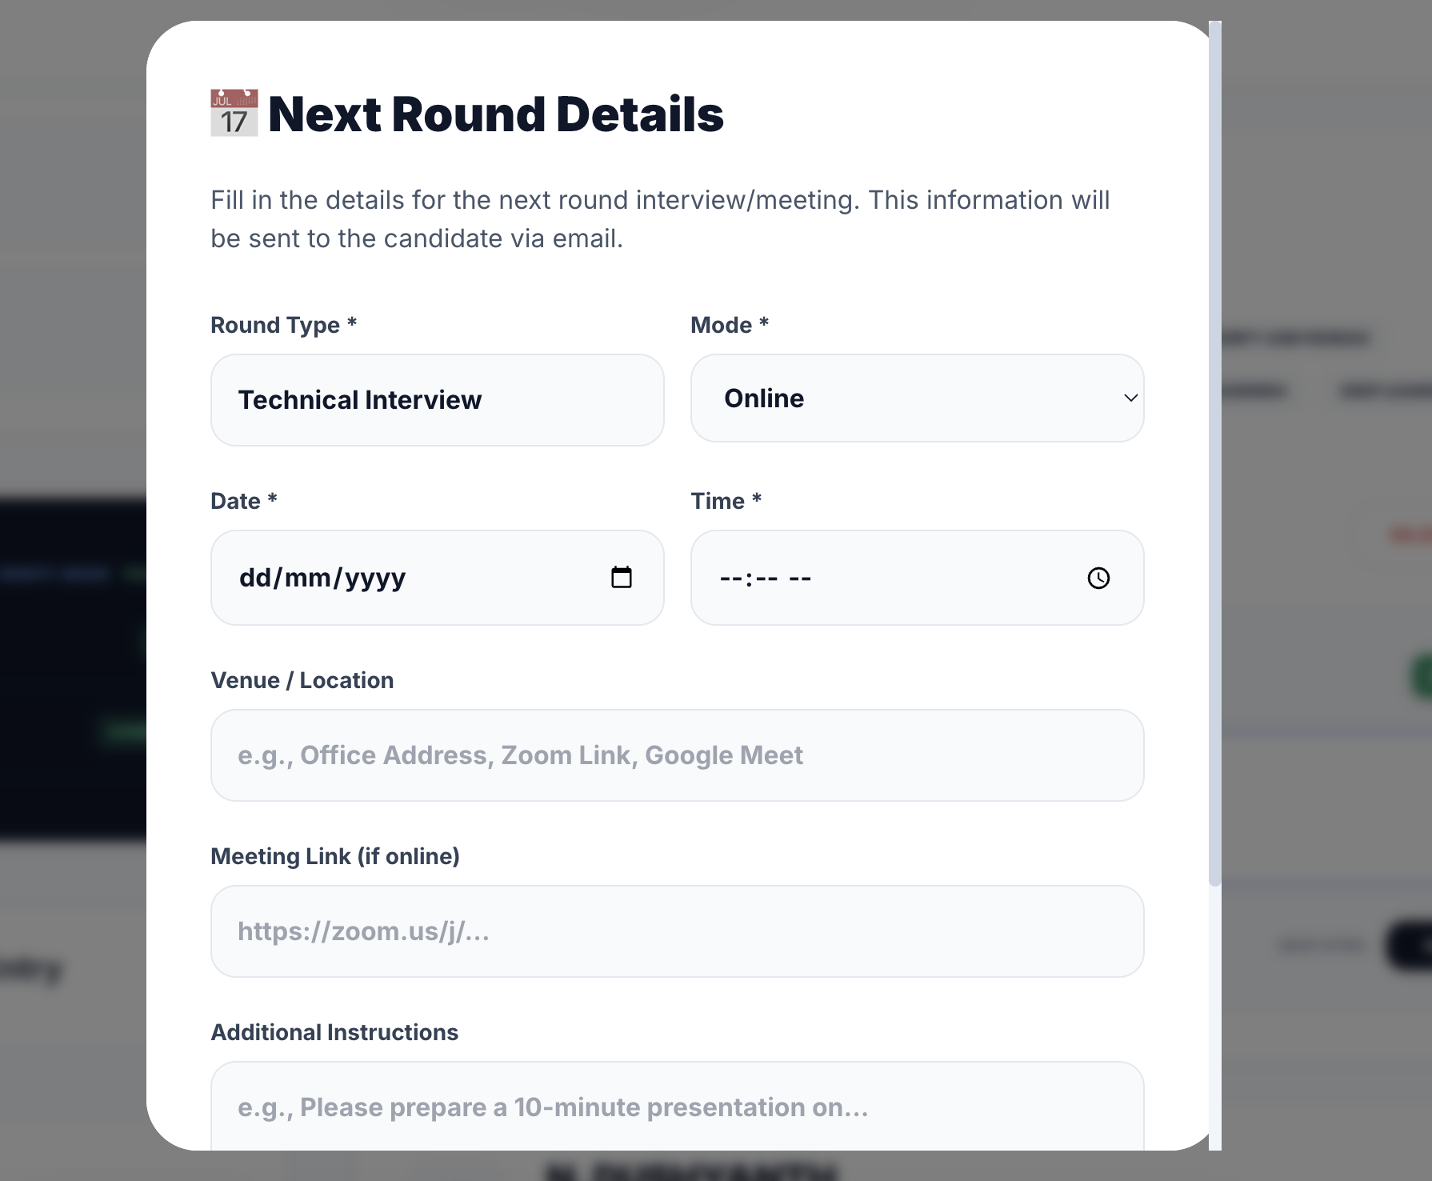
IMPLEMENTATION SCREENSHOTS
1
2
3
4
5
6
7
8(C)
9
This image shows a Next Round Interview Details form in a Job Portal Management System. It allows recruiters to schedule the next stage of the hiring process by entering details such as interview type, date, time, and location. The system also provides options to add meeting links and instructions, which are sent to candidates for further communication.

Slide 16
ADVANTAGES & LIMITATIONS
>ADVANTAGES
Reduces manual work and paperwork in recruitment
Saves time with quick online job search and application
Minimizes errors in candidate data and application management
Provides real-time updates on job postings and application status
Easy access from anywhere (web-based platform)
> LIMITATIONS
Requires stable internet connection
Depends on system/server availability
Initial development and maintenance cost
Risk of technical issues or software bugs
Users need basic digital literacy
1
2
3
4
5
6
7
8
9

Slide 17
Thank you

